Slide 1


WEATHER PREDICTION USING MACHINE LEARNING

Slide 2


PRESENTED BY :
SWEETY KUMARI :24SCSE2030462
DIYA KUMARI :24SCSE2030284
ANKITA RAJ :24SCSE20300096

Slide 3

CONTENTS
Introduction
OBJECTIVES
METHODOLOGY
BLOCK DIAGRAM
DATA COLLECTION AND PREPROCESSING
MODEL DEVELOPMENT
CHALLENGES FACED
CONCLUSION AND FUTURE WORK
REFERENCES

Slide 4
Introduction
Weather prediction, also known as weather forecasting, is the process of using scientific principles and technology to predict the atmospheric conditions for a specific location and time.
Weather predictions are created by gathering objective data about the actual condition of the atmosphere at a certain location and using meteorology to predict how the weather will behave in the future.
Weather Forecasting is crucial since it helps to determine future climate changes. With the use of latitude, we can determine the probability of snow and hail reaching the surface.

Slide 5

Objectives
This project aims to address critical challenges, optimize efficiency, and deliver actionable results aligned with the project objectives.
The purpose of a weather prediction project is to create a weather application that can accurately display weather forecasts for a given location.
Machine Learning in weather prediction has led to significant advancements, resulting in improved forecasting accuracy, faster predictions, and better handling of complex weather patterns.

Slide 6

Methodology
This project provides real-time information on cloud cover, temperature, humidity, wind patterns, and precipitation.
This project Used to identify trends, seasonal patterns, and anomalies that improve forecast accuracy.
Tools and technologies used are Python, machine learning models.
Machine Learning is a subset of artificial intelligence that is mainly concerned with the development of algorithms which allow a computer to learn from the data and past experiences on their own. The term machine learning was first introduced by Arthur Samuel in 1959.
Machine learning enables a machine to automatically learn from data, improve performance from experiences, and predict things without being explicitly programmed.

Slide 7
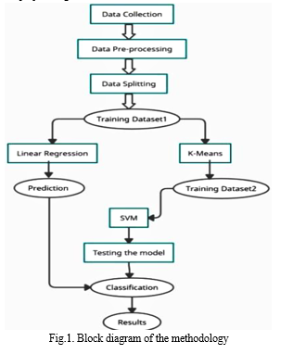

BLOCK DIAGRAM OF THE METHODOLOGY

Slide 8

Data Collection and Preprocessing
This dataset contains weather data for various Indian cities, focusing on their current temperature.
The dataset allows users to input the name of any city, and it returns the current temperature for that specific location.
The data is collected from reliable sources and provides real-time temperature readings in Celsius (°C).
The dataset is designed to help users easily access temperature information for any city in India.
Tools and software used for our project is python and OpenWeatherAPI.

Slide 9

Model Development
Algorithm used in this project is Random Forest Regressor.
Machine Learning Algorithm: A machine learning algorithm is a method or set of rules that a model follows to learn patterns from data and make predictions.
In this case, Random Forest Regressor is a type of supervised learning algorithm used for regression tasks (predicting continuous values).
Random Forest Regressor is an ensemble learning method that combines the predictions of multiple individual decision trees to improve accuracy and control overfitting.

Slide 10
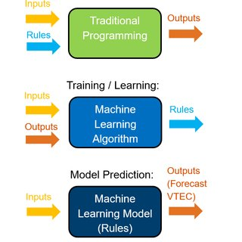

To be continue..
Model Training:
"The Random Forest Regressor was trained on the training set using default parameters (or tuned parameters)."
Validation Metrics: Specify the metrics used to evaluate the model's performance (e.g., Mean Absolute Error, R-squared, Mean Squared Error).
"The model was validated using Mean Absolute Error (MAE) to measure the average difference between the predicted and actual values."

Slide 11

Challenges Faced
"One limitation of the system is that it only provides temperature data, while other weather parameters like humidity, precipitation, and wind speed are not yet included. Additionally, the system relies on third-party weather APIs, which may sometimes experience downtime or data inaccuracies.“
"One challenge faced during the project was ensuring the accuracy of the weather data. Weather APIs provide data from different sources, and inconsistencies in data quality or delayed updates can sometimes lead to discrepancies in the displayed temperature readings.“
"The reliance on third-party weather APIs posed challenges due to rate limits or API downtime, which occasionally interrupted access to real-time data and impacted the functionality of the system."

Slide 12
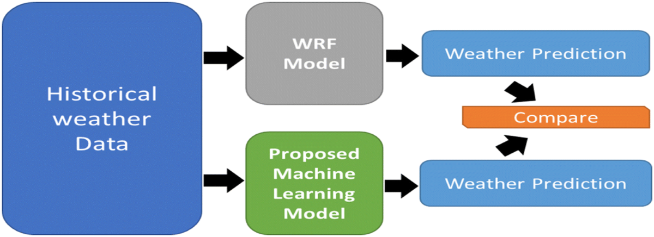

To be continue..
"Since the system depends on the internet to retrieve real-time weather data, network connectivity issues or slow internet speeds sometimes caused delays in fetching the data or even prevented it from being retrieved altogether.“
"The system faced performance issues when handling multiple simultaneous city queries. Ensuring that the application can process and return temperature data for many cities at once, without lag, was a challenge that required optimization.“
The system sometimes struggled with large numbers of requests, particularly when fetching weather data for a large number of cities in a short period of time.“

Slide 13

Conclusion and Future Work
In this project, we successfully developed a weather prediction system that provides real-time temperature data for any given city in India.
Using current weather data from reliable APIs, the system is able to provide accurate and timely temperature readings for users.“
“The system allows users to simply enter the name of a city and retrieve the current temperature instantly, demonstrating the effectiveness of real-time data integration and user-friendly design.“

Slide 14

To be continue..
"The weather prediction tool proved to be highly reliable, offering accurate temperature readings based on up-to-date weather data, making it an essential tool for individuals planning their day-to-day activities.“
"Future work could focus on expanding the weather parameters beyond temperature to include real-time data on humidity, wind speed, precipitation, and weather forecasts for the next few days. This would offer a more comprehensive view of the weather conditions.“
"Incorporating machine learning models to predict future temperature trends based on historical data and current conditions could further enhance the system's usefulness, allowing users to receive weather forecasts rather than just current data."

Slide 15
References
We collected data from:
Google and
OpenWeatherAPI.
Tools and frameworks used are:
pandas,
numpy,
Matplotlib and
Seaborn.

Slide 16

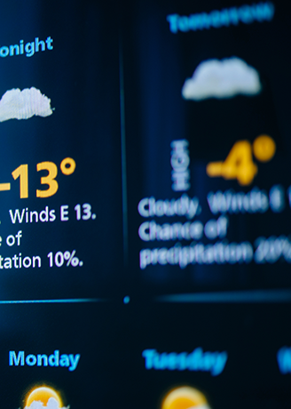
THANK YOU

